Slide 1










Glaucoma Disease Detection using Convolution Neural Network
Presented by
711621243302
III AI&DS
AD3511 DEEP LEARNING LABORATORY 2023-2024(ODD SEM)

Slide 2
OUTLINE OF PRESENTATION
Introduction
Concept
Problem statement and Flow diagram
Algorithm
Data Set
Methodology
Conclusion
Bibliography (Reference of websites used)

Slide 3
Introduction
Glaucoma is a disease that relates to the vision of the human eye.
The differentiation between the patterns formed for glaucoma and non-glaucoma can be find out with the use of the CNN.
The CNN provides a hierarchical structure of the images for differentiation. Proposed work can be evaluated with a total of six layers.
Training data sets of previously classified images are used to develop the system.

Slide 4
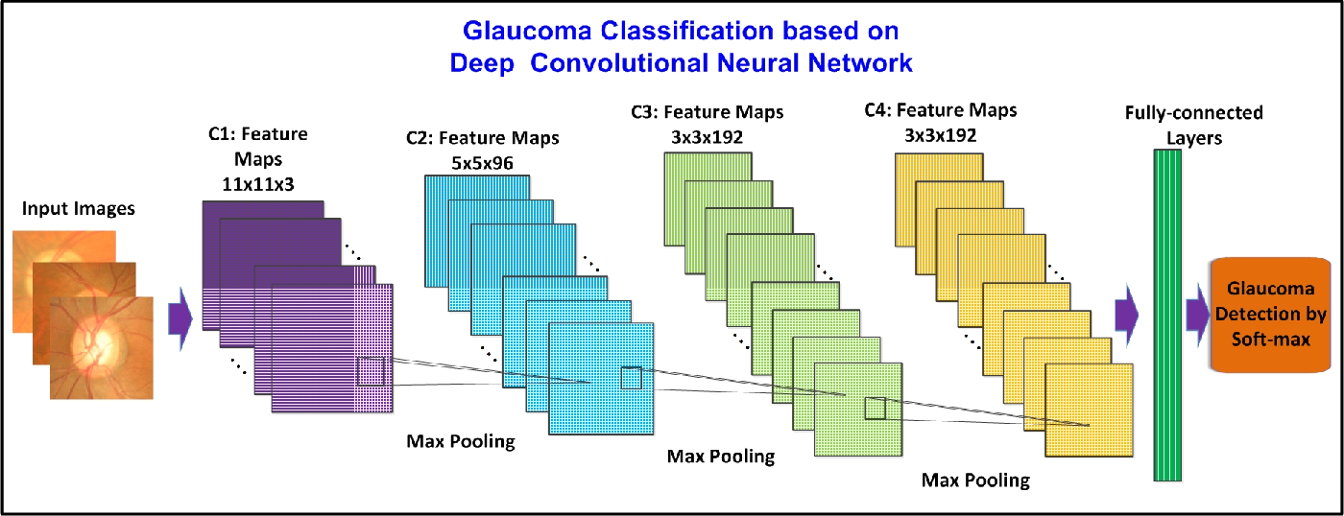
Concept
Convolutional Neural Networks (CNNs) have been employed in the field of ophthalmology to aid in the detection of glaucoma

Slide 5
Problem Statement
Glaucoma is a group of eye diseases that can cause damage to the optic nerve and lead to vision loss. Early detection and diagnosis of glaucoma are crucial for effective treatment and management. So, we have proposed a Convolutional Neural Network (CNN) system for early detection of Glaucoma

Slide 6
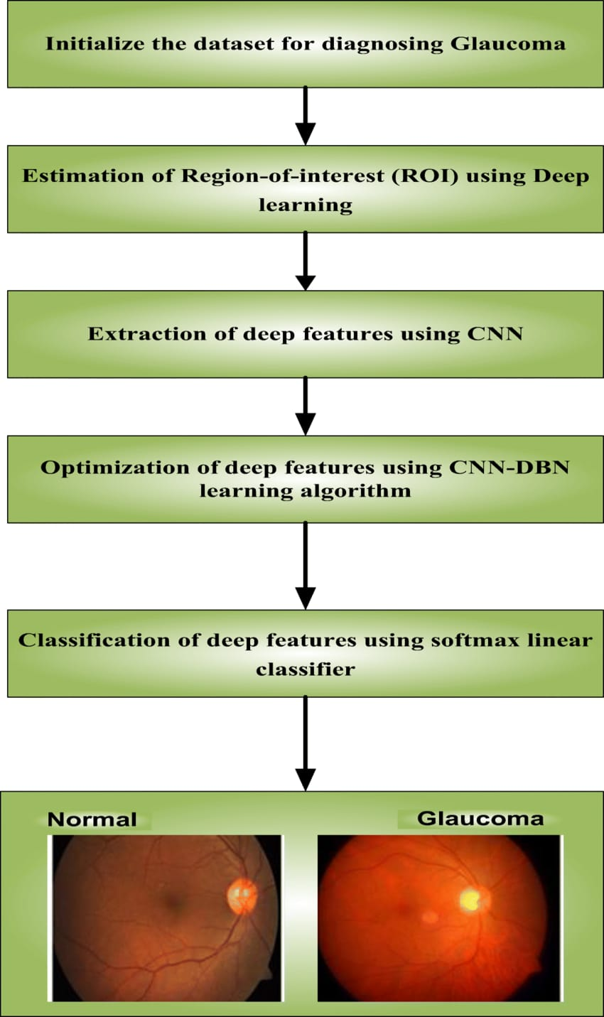
Flow diagram

Slide 7
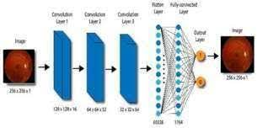
Methodology
Image Data Collection
Data Preprocessing
Model Architecture
Training
Validation and Testing
Model Interpretation
Deployment

Slide 8
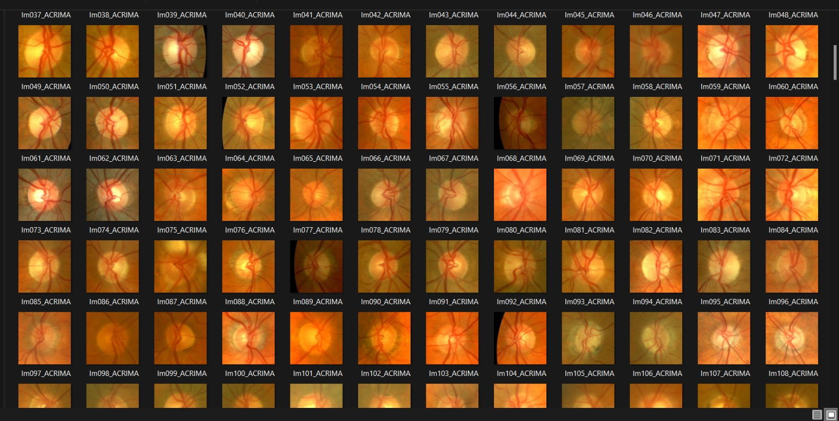
Dataset
Glaucoma disease dataset from Kaggle
The database contains eye images for training and testing. Out of 100 images, 50 images contain glaucoma and 50 images are healthy (without glaucoma). All the images are of varying sizes and in different formats.

Slide 9
Conclusion

Slide 10
Thank you

